Slide 1
Current Issues in DUI Defense Cobb County Bar Association Criminal Defense Section CLE March 21, 2025
Notes:
OTO

Slide 2
@weinerraters
@bensessions
Notes:
OTO

Slide 3
“So, what’s the new, good stuff in DUI law?”
Notes:
BEN

Slide 4
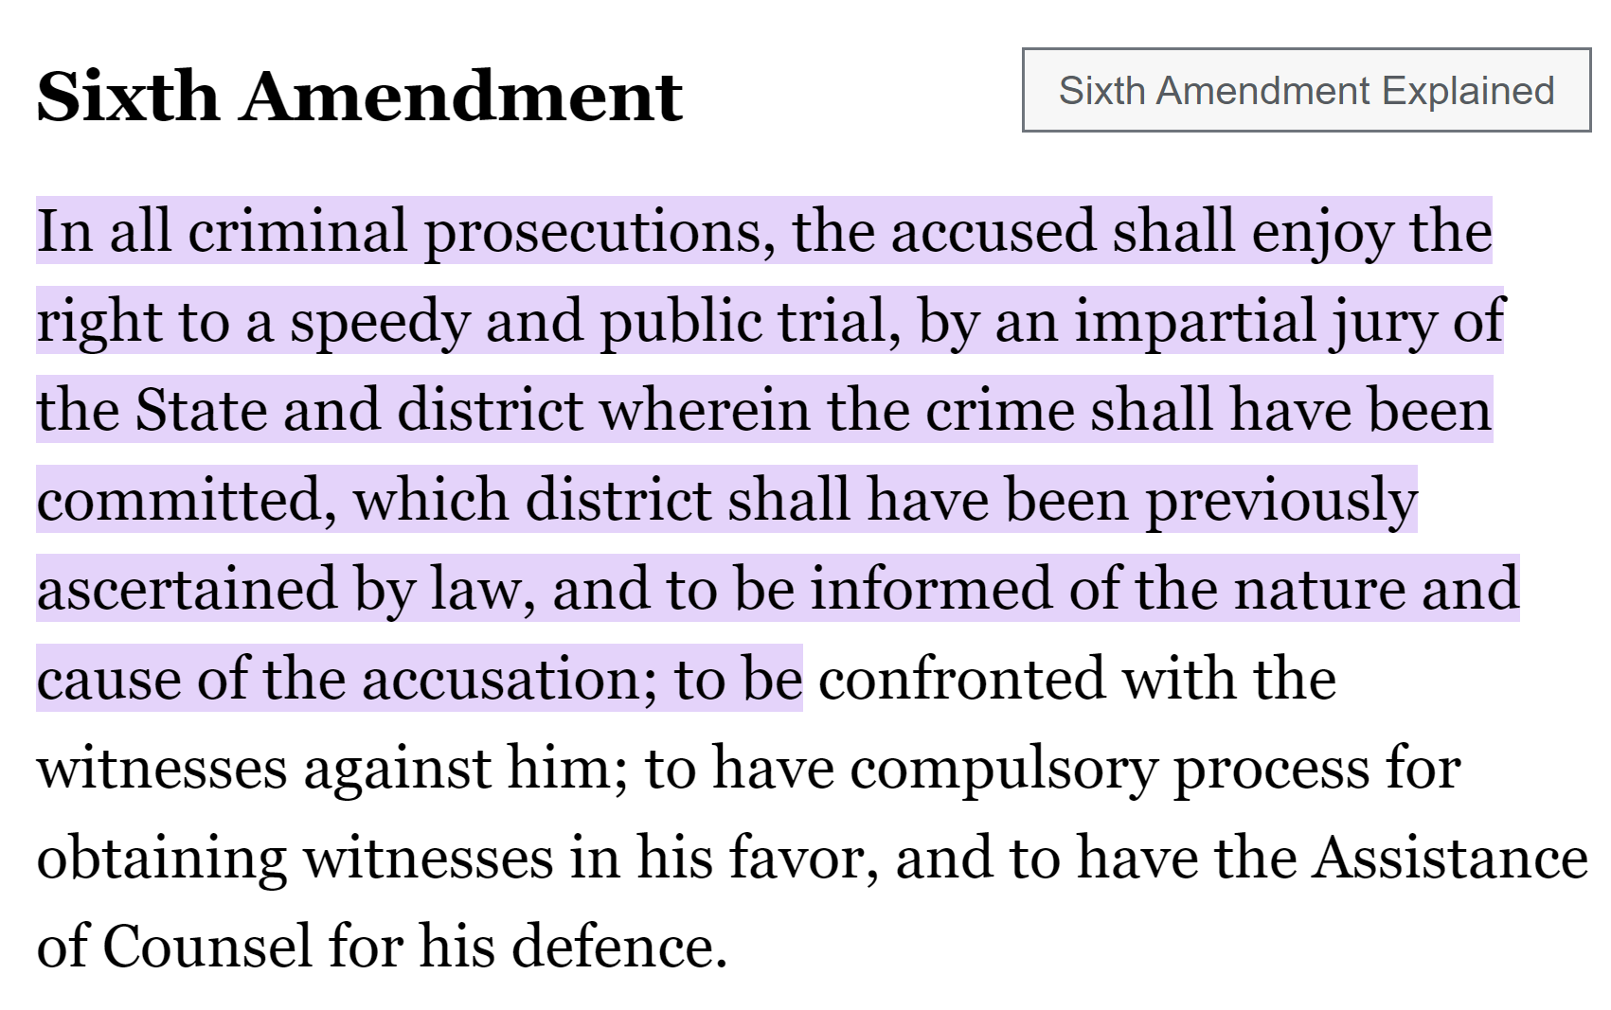

Slide 6
https://www.thesessionslawfirm.com/about-our-firm/resources/

Slide 7
OVERVIEW OF THE GOOD NEWS
Getting off on the right foot – particularization of motions
a/k/a get out of here with that junk
The greatest gift of this year - Jones
My favorite issue
DAUBERT MOTIONS
SEARCH WARRANTS – don’t let them take shortcuts
My Pet project
Is the statute of limitations still a thing?
Don’t sleep on constitutional speedy motions – judges keep messing it up

Slide 8
My Goals
To help you identify some of the good issues from recent cases
To help you understand how to apply those cases
Notes:
BEN

Slide 9
Is there anything more anxiety-ridden than hearing that whining about “but these motions aren’t particularized?
I hate that.
Notes:
BEN

Slide 10
Particularization wasn’t ever really a problem, but this is just a reminder…
Motion here adequately advised State “that Cochran was challenging the traffic stop and his arrest. [Cits.] Further, ‘[t]he motion in this case was sufficient to put the [S]tate on notice as to the type of search involved (without warrant vs. with warrant), which witness to bring to the hearing on the motion, and the legal issues to be resolved at that hearing.’ Lavelle v. State, 250 Ga. 224, 227(3), 297 S.E.2d 234 (1982).”
Cochran v. State, 371 Ga.App. 391, 900 S.E.2d 213 (March 28, 2024).

Slide 11
We love cases that increase/CLARIFY the burden on the state at motions.
For years, I’ve loved Burrell. It helped me take advantage of missing links in the chain of proof at motions.
Burrell v. State, 261 Ga. App. 677, 583 S.E.2d 521 (2003).
Well, we have a new case that is every bit as helpful to us.
It’s great for DUI, drugs, all sorts of circumstance….
Notes:
BEN

Slide 12
The greatest gift of THE LAST year - Jones
“[T]he State failed to establish why it was reasonable for the officer to detain Jones while waiting for a second unit without performing any field sobriety tests when the evidence showed that (1) the officer was certified to perform two of the field sobriety tests he eventually performed; (2) he had a PBT in his patrol car which he eventually used on Jones; and (3) the deputy never disclosed to the officer the results of the HGN test. Moreover, although the officer testified that it was his routine practice to wait for backup before conducting a DUI investigation ‘for both parties’ safety, if anything,’ the trial court seemingly rejected this rationale as unreasonable given that the officer spent the time waiting outside his patrol car engaging in small talk with Jones. We, therefore, conclude that the trial court did not err in granting the motion to suppress on the ground that the detention was unreasonably prolonged.”
State v. Jones, 371 Ga. App. 445, 900 S.E.2d 749 (April 22, 2024).
Notes:
BEN

Slide 13
SEARCH WARRANTS

Slide 14
Search Warrants – The Basics
Defendant argues the evidence should be suppressed because the State failed to introduce the affidavit used to obtain the warrant at the suppression hearing. We agree with the defendant that the State is required to introduce the affidavit supporting the issuance of the search warrant in response to a motion to suppress challenging the sufficiency of the affidavit and validity of the warrant. “[W]hen a motion to suppress is made on one of the three statutory grounds, challenging the validity of a search and seizure with a warrant, the burden of showing that the search and seizure were lawful shall be on the state. This burden upon the State is satisfied by production of the warrant and its supporting affidavit, and by showing either by those documents or by other evidence that the warrant is not subject to the statutory challenge alleged.” (Emphasis supplied.) State v. Slaughter, 252 Ga. 435, 439, 315 S.E.2d 865 (1984).
Gates v. State, 229 Ga. App. 766, 767, 495 S.E.2d 113, 114–15 (1997)
Notes:
BEN

Slide 15
Search Warrants – Look at how far the State will go to avoid getting a search warrant.
After a serious injury accident, sheriff’s officer obtained an ex parte order from superior court pursuant to OCGA § 24-12-1, directing the hospital to furnish defendant’s medical records to the sheriff’s department without disclosing that fact to anyone.
Gates v. State, 317 Ga. 889, 896 S.E.2d 536 (December 19, 2023).
Notes:
BEN

Slide 16
Search Warrants – Look at how far the State will go to avoid getting a search warrant.
The ex parte order violated the defendant’s right to privacy under Article I, Section I, Paragraph I of the Georgia Constitution. The ex parte order was similar to the subpoena disapproved in King v. State, 272 Ga. 788, 535 S.E.2d 492 (2000). All they had to do was get the search warrant approved of in King v. State, 276 Ga. 126, 129(2), 577 S.E.2d 764 (2003).
Like the subpoena in King I, the order here did not require any finding of probable cause, and therefore was not an “appropriate” order as contemplated by OCGA § 24-12-1. By contrast, the search warrant in King II did require a finding of probable cause, and so did not violate the defendant’s right to privacy.
Gates v. State, 317 Ga. 889, 896 S.E.2d 536 (December 19, 2023).
Notes:
BEN

Slide 17
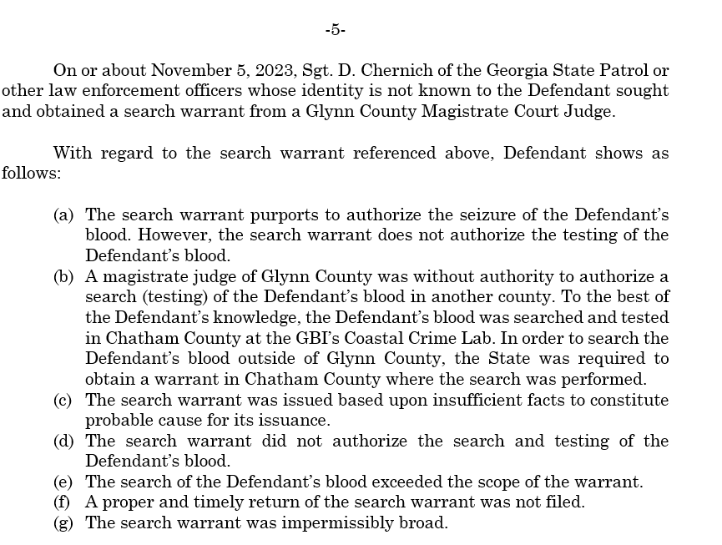

Slide 18
Remember De la Paz? The testing being a search is important!
In State v. De la Paz, officers received a warrant to search a defendant’s blood for alcohol. But, without seeking an additional warrant, they then tested his blood for drugs. The Court of Appeals held that this was a separate search and that, without a warrant to authorize that search, the officers could not conduct the additional test. “Because th[e] warrant was limited to alcohol testing and did not contemplate or authorize testing for drugs, the subsequent testing for drugs was unauthorized.”
State v. De la Paz, No. A23A1769, at *11 (Ga. Ct. App. Mar. 8, 2024).
Notes:
OTO

Slide 19
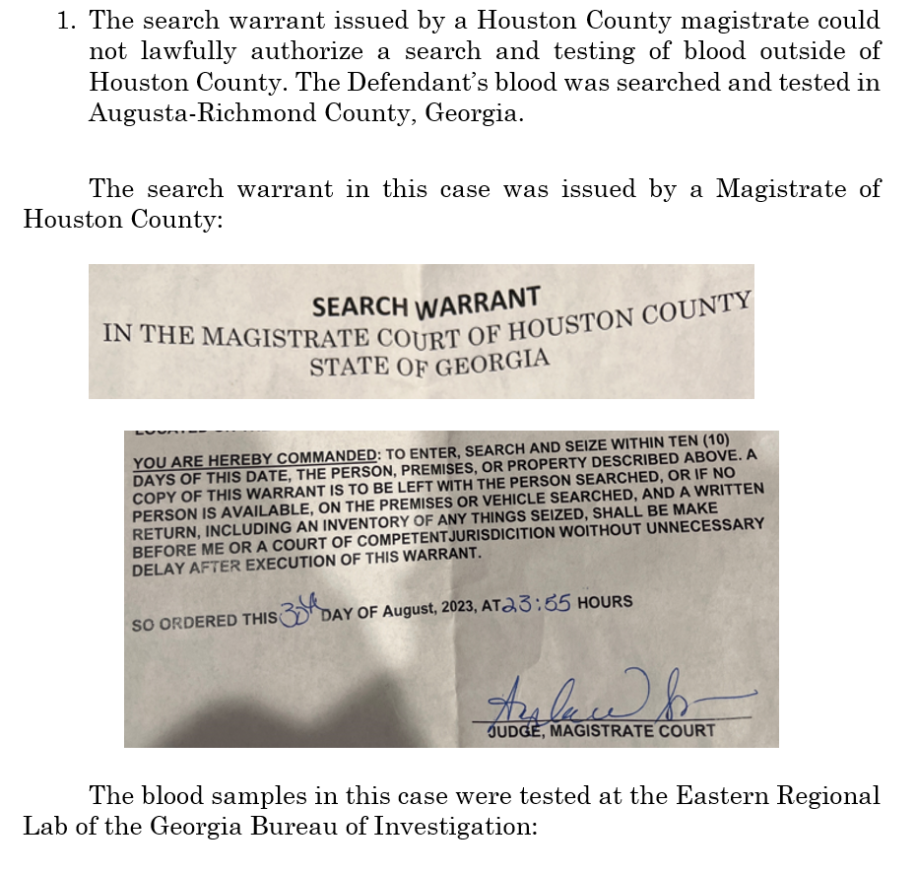
Notes:
BEN

Slide 20
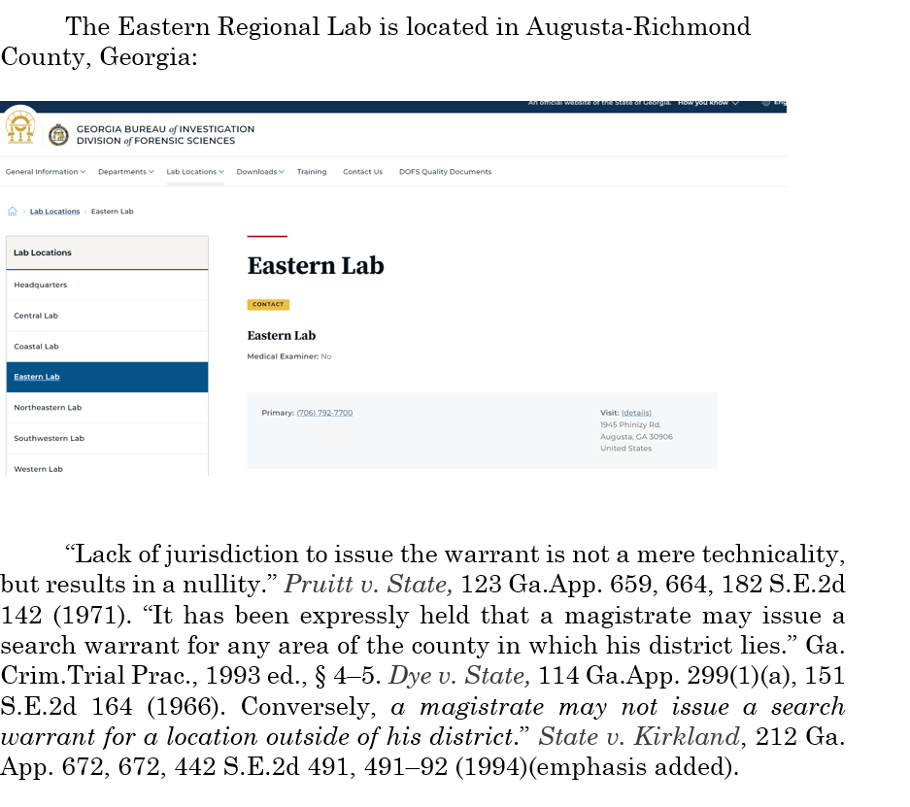
Notes:
BEN

Slide 21
My Favorite Issue: Withdrawing Consent to Testing
You MUST timely withdraw consent to testing of the blood.
Do it by email to the crime lab.
File your motion to suppress raising withdrawal of consent as one of the grounds.
Notes:
OTO

Slide 22
Notes:
OTO

Slide 23
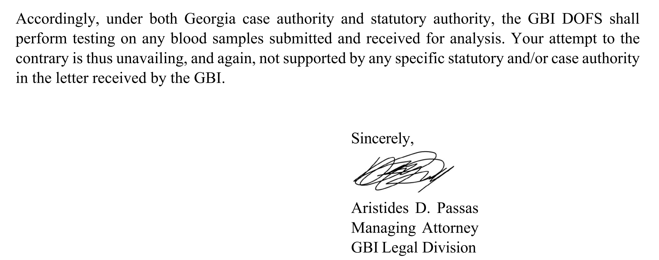
Notes:
OTO

Slide 24
My Favorite Issue: Withdrawing Consent to Testing
Why do I love this issue?
First, the testing is a “separate” search:
In State v. De la Paz, officers received a warrant to search a defendant’s blood for alcohol. But, without seeking an additional warrant, they then tested his blood for drugs. The Court of Appeals held that this was a separate search and that, without a warrant to authorize that search, the officers could not conduct the additional test. “Because th[e] warrant was limited to alcohol testing and did not contemplate or authorize testing for drugs, the subsequent testing for drugs was unauthorized.”
State v. De la Paz, No. A23A1769, at *11 (Ga. Ct. App. Mar. 8, 2024).
Notes:
OTO

Slide 25
My Favorite Issue: Withdrawing Consent to Testing
What’s the argument?
De la Paz’s holding controls here. The State may not argue that consent to draw the Defendant’s blood then authorized any potential later test, any more than a warrant could authorize any potential later test. And because the Court of Appeals has held that this later test is a separate search, the State requires either a warrant or consent to conduct it. See Williams v. State, 296 Ga. 817, 819, 771 S.E.2d 373, 375 (2015) (holding that the extraction of blood is a search).
Here, the defendant withdrew his consent before testing was conducted. “"[O]nce consent is legally obtained, it continues until it is either revoked or withdrawn” Winslow v. State, 315 Ga. 133, 136 (Ga. 2022).
Notes:
OTO

Slide 26
Georgia’s Current Expert/Scientific Opinion Rule
§ 24-7-702. Expert testimony; qualifications as expert
(b) A witness who is qualified as an expert by knowledge, skill, experience, training, or education may testify in the form of an opinion or otherwise, if:
The expert's scientific, technical, or other specialized knowledge will help the trier of fact to understand the evidence or to determine a fact in issue;
The testimony is based upon sufficient facts or data;
The testimony is the product of reliable principles and methods; and
The expert has reliably applied the principles and methods to the facts of the case.

Slide 27
Can trial judges rely upon Harper cases to decide Daubert?
No.
For expert testimony rulings in criminal cases, look to state appeals court decisions based on fact patterns on and after July 1, 2022.

Slide 28
When the precedent was decided is important.
And we have expressly held that where a provision of our current Evidence Code is materially identical to the Federal Rules of Evidence, the new provision “reflects the federal rule's meaning, displacing any other.” Almanza, 304 Ga. at 558 (2), 820 S.E.2d 1. In such instances, Georgia courts should not look to cases decided under the former Evidence Code because that precedent did not survive the adoption of the new Evidence Code.
Miller v. Golden Peanut Co., LLC, 317 Ga. 22, 28, 891 S.E.2d 776, 782–83 (2023).

Slide 29
But, does the adoption of Rule 702 actually improve the quality of evidence?
We appear not yet to have expressly analyzed the extent to which the Daubert standard and the former Harper standard differ. But see Ronald L. Carlson & Michael Scott Carlson, Carlson on Evidence 416, 441 (9th ed. 2024) (characterizing Harper standard as “more liberal” than Daubert). We make no detailed holding on that important question today, other than to clarify that they are not the same.
Garrison v. State, 319 Ga. 711, 725, 905 S.E.2d 629, 642 (2024)

Slide 30
Miller v. Golden Peanut Company, LLC
317 Ga. 22, 891 S.E.2d 776 (2023)
We must know this case.
2023 decision by the Georgia Supreme Court.
Analyzes ways in which an investigating police officer may be called to provide both lay and expert testimony at trial.

Slide 31
Miller v. Golden Peanut Company, LLC
Investigating officer’s testimony:
For unknown reasons, [decedent] did not recognize the tractor-trailer being driven by [truck driver] entering the roadway from a private...field drive. It is the opinion of this investigating officer that [decedent] was distracted by something and failed to slow her vehicle down to allow the trailer to clear her travel lane [before the collision].

Slide 32
Miller v. Golden Peanut Company, LLC
Trial court denied the plaintiff’s motion to exclude relying on a line of cases which concluded that investigating officers were presumptively qualified as experts. See e.g., Fortner v. Town of Register, 289 Ga. App. 543, 545 (1), 657 S.E.2d 620 (2008).
Trial court: officer did not need to meet the additional evidentiary burdens as set forth in O.C.G.A. §24-7-702 and Daubert.

Slide 33
Miller v. Golden Peanut Company, LLC
Despite Daubert, the Court of Appeals applied the “investigating officer exception”
Court of Appeals affirmed the trial court’s order refusing to exclude the testimony of the investigating officer:“[I]t has long been recognized that a police officer with investigative training and experience on automobile collisions is an expert, although of course the credibility and weight to be given his testimony is for the jury.”

Slide 34
Miller v. Golden Peanut Company, LLC
Questions Posed by Georgia Supreme Court:
(a) Under what circumstances must a law enforcement officer who conducts an investigation in a civil case be qualified as an expert under O.C.G.A. §24-7-702 if the officer’s testimony offers both lay and expert opinions?
(b) How do you determine what part of the testimony is lay testimony which is governed by Rule 701 and what part is expert testimony which is governed by Rule 702?

Slide 35
Miller v. Golden Peanut Company, LLC
Georgia Supreme Court:
“[N]othing in the language of Rule 702 supports the trial court's conclusion that an investigating officer's testimony is somehow exempted from the statute's admissibility standard or comports with White's argument that the investigating officer rule is somehow a streamlined version of Daubert’s clear standards. Accordingly, we conclude that when an investigating officer is called to provide an expert opinion, the trial court must perform the same gatekeeping function under Rule 702 that it is required to do with all expert witnesses.”
Miller v. Golden Peanut Co., LLC, 317 Ga. 22, 29–30, 891 S.E.2d 776, 783 (2023)
Notes:
OTO

Slide 36
Miller v. Golden Peanut Company, LLC
The Supreme Court noted that all parties agreed that the investigating officer’s background, education and experience qualified him to speak as an expert on the topic of accident reconstruction.
However, the Supreme Court ruled that the trial court failed to exercise its gatekeeping duties under Daubert because the trial court failed to assess the remaining two prongs of Daubert: the reliability of the expert’s methodology and whether the testimony would be helpful to a juror.

Slide 37
Miller v. Golden Peanut Company, LLC
“While invariably there is some overlap in the basic [Daubert] requirements—qualification, reliability, and helpfulness—they remain distinct concepts and the courts must take care not to conflate them,”
Citing United States v. Frazier, 387 F.3d 1244, 1260 (III)(A) (11th Cir. 2004).

Slide 38
Miller v. Golden Peanut Company, LLC
The “reliability” prong requires a case specific inquiry because there are many different kinds of experts and many different kinds of expertise.
The test of reliability is a flexible one, the specific factors [listed in Daubert] are neither necessarily nor exclusively to be applied to all experts in every case.

Slide 39
Miller v. Golden Peanut Company, LLC
The “helpfulness” prong of a Daubert analysis means that the proposed testimony must “logically advance” a “material aspect” of the case. [citations omitted]
To be ‘helpful’ the testimony must “fit” an issue that the jury is charged with deciding. [citations omitted]
Expert testimony generally helps the trier of fact when it concerns matters that are beyond the understanding of the average lay person and “has a justified scientific relationship to the pertinent facts” [citations omitted]

Slide 40
Key Lessons from Miller v. Golden Peanut Company, LLC
Investigating officers can present both lay and expert opinion testimony.
When investigating officers present expert testimony, Daubert applies.
For expert opinions offered by investigating officers, proponent must demonstrate that the three prongs of Daubert are satisfied: qualification, helpfulness and reliability.

Slide 41
I hate war stories.
But, indulge me. And let me show you how difficult it is move a Judge from a previously established position – even if they happen to be the Judge in Miller v. Golden Peanut.

Slide 43
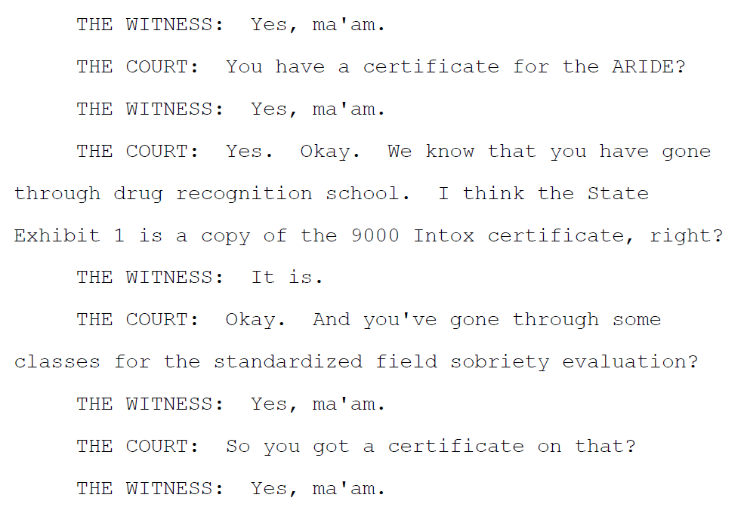

Slide 44
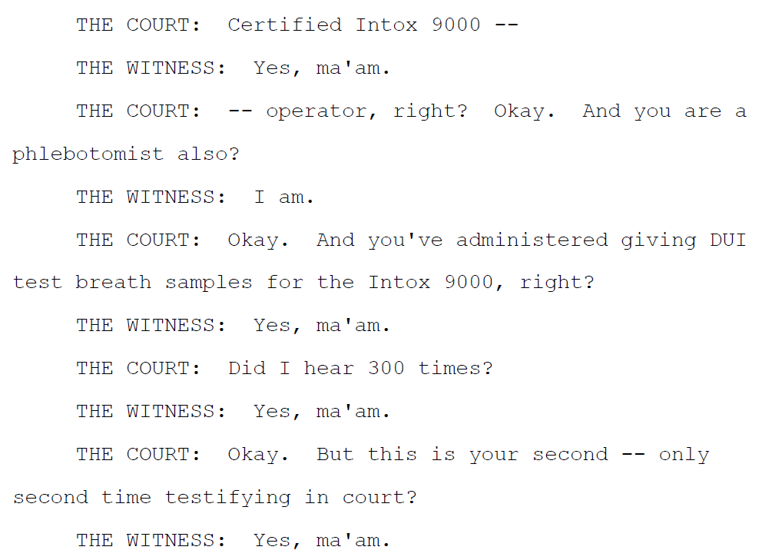

Slide 45
Horizontal Gaze Nystagmus Test Evidence
Accordingly, when Garrison objected on Daubert grounds, the trial court should have considered Trooper McSweenyy's qualifications to testify as to the HGN test as well as the relevance and reliability of the proffered testimony based on the Daubert standard, including the reliability factors listed above. But no such consideration is apparent from the record; rather, the trial court overruled Garrison's objection before Garrison's attorney had finished the sentence containing the objection. The State made no proffer as to the reliability of HGN testing in the context of this case, much less any of the specific reliability factors. As such, the record before us does not appear to contain evidence from which the trial court could have found, or from which we could determine in the first instance, that Trooper McSweenyy's testimony about the HGN test satisfied the Daubert standard.
This is not to say that Trooper McSweenyy's HGN-related testimony could not satisfy the Daubert standard. Rather, the record before us is too scant for the trial court to have made that determination. And the record before us is too scant for us to make that determination for the first time on appeal. This is especially so given that no reported Georgia decision has ever considered the reliability of HGN-related evidence under the Daubert standard. As a “court of review,” see Ga. Const. of 1983, Art. VI, Sec. VI, Par. II, we decline to do so in the first instance. Therefore, we cannot conclude on this record that the proper analysis would have resulted in a determination that the challenged evidence was admissible.
Garrison v. State, 319 Ga. 711, 727, 905 S.E.2d 629, 643 (2024)

Slide 46
Retrograde Extrapolation – This is one to note.
Footnote 7 – “To be clear, all that we decide today is that Sowell cannot show that the trial court committed plain error by allowing Turner to testify about retrograde extrapolation at trial. We leave for another day the issue of whether such testimony is admissible under OCGA §
Sowell v. State, 373 Ga. App. 192, 199, 908 S.E.2d 34, 39 (2024), cert. denied (Jan. 28, 2025)

Slide 47
HGN Test
Trial court summarily overruled the objection, without allowing counsel to even finish his sentence, let alone expound on it. The court thus made no ruling on the trooper/witness’s qualifications to perform the test or “the relevance and reliability of the proffered testimony based on the Daubert standard.” Nor did the State proffer any evidence supporting its admission under Daubert. Thus, the record is too “scant” to determine the admissibility of the evidence, “especially so given that no reported Georgia decision has ever considered the reliability of HGN- related evidence under the Daubert standard.”
Garrison v. State, S24G0007, Ga. , S.E.2d , 2024 WL 3802691 (August 13, 2024).

Slide 48
Refusal of State Blood Tests
Defendant here not only challenged the constitutionality of the statutes, but also argued for exclusion of the evidence under Rule 403 as being substantially more prejudicial than probative. The trial court erred by failing to rule on this argument before taking up the constitutionality issue. “[The Rule 403] argument ‘presents a threshold issue of constitutional avoidance’ because if evidence of his refusal to consent to the blood test is due to be excluded as more prejudicial than probative, there will be ‘no occasion to reach the merits of his constitutional claim.’ State v. Mondor, 306 Ga. 338, 344-345(2), 830 S.E.2d 206 (2019). Thus, rather than ‘jumping straight to the constitutional question[,] [t]he trial court should have resolved the statutory question first.’ Deal v. Coleman, 294 Ga. 170, 171(1) n.7, 751 S.E.2d 337 (2013).”
State v. Randall, 318 Ga. 79, 897 S.E.2d 444 (January 17, 2024).

Slide 49
Refusal of State Blood Tests
Instead, the state constitutional issue argued below is novel; the trial court did not engage with the novelty. Vacatur and remand for consideration of the actual novel issue is appropriate in such circumstances. But it's also appropriate for another reason: our caselaw has over and over again made clear that Georgia courts should not reach a constitutional challenge to a state statute if there's an alternative ground on which to decide the case. See, e.g., State v. Randall, 318 Ga. 79, 81-82 (2), 897 S.E.2d 444 (2024); Sons of Confederate Veterans v. Henry County Bd. of Commissioners, 315 Ga. 39, 65 (2) (d) (i), 880 S.E.2d 168 (2022) (citing Deal v. Coleman, 294 Ga. 170, 171 (1) n.7, 751 S.E.2d 337 (2013)).
State v. Dias, No. S24A1373, 2025 WL 795316, at *3 (Ga. Mar. 13, 2025)

Slide 50
This is awesome.
Evidence that someone refuses to consent to a warrantless search may be relevant in the sense that it provides nonzero probative value to prove consciousness of guilt. But it seems to me that the probative value of that evidence will rarely be more than barely nonzero. There are a host of reasons why a completely law-abiding Georgian may decline to consent to a warrantless search:
• They might be busy.
• They might be in a bad mood.
• They might be late — to work, to pick up a child, or some other important errand.
• They might be afraid of, or suspicious of, law enforcement, and therefore wary of prolonging their encounter.
• They might have a deeply held appreciation for our hard-won constitutional rights and are simply declining on principle.
• They might have a host of other reasons that the cost of publishing these opinions renders unwise for me to continue enumerating.
• And when the warrantless search for which consent is requested involves needles puncturing their skin — as the one here did — they might just have a thing about needles and/or the sight of their own blood.
State v. Dias, No. S24A1373, 2025 WL 795316, at *3–4 (Ga. Mar. 13, 2025)

Slide 51
Refusal of State Blood Tests
All of those are perfectly good reasons not to consent. None of those reasons offer any basis for suspecting the nonconsenting person of crime. And so the mere fact that a person asked by law enforcement if they will allow a warrantless blood draw says “no” — an answer both the United States and Georgia Constitutions vest every Georgian with the absolute right to give — usually cannot be said to have much more than barely nonzero probative value as to guilt of a suspected crime.
But when a Georgian says “no” when asked to submit to a warrantless blood draw and a prosecutor then seeks to offer that response as affirmative evidence of guilt, the risk of unfair prejudice will often be much higher than barely nonzero.
And whether or not that alternative ground is ultimately dispositive, the trial court has not yet addressed it.⁸ It should do so on remand before reaching any constitutional issues. See Randall, 318 Ga. at 82 (2), 897 S.E.2d 444 (trial court should have resolved Rule 403 argument before reaching constitutional challenge to admissibility of blood test refusal evidence).
State v. Dias, No. S24A1373, 2025 WL 795316, at *4 (Ga. Mar. 13, 2025)

Slide 52
We don’t raise constitutional speedy trial motions enough.
Notes:
OTO

Slide 53
Constitutional Speedy Motions: Judges keep messing them up.
Analysis was required notwithstanding counsel’s failure to appear for hearing. Distinguishing Oni v. State, 268 Ga.App. 840, 602 S.E.2d 859 (July 30, 2004) (counsel waived statutory speedy trial demand by failing to appear for hearing, among other things). 2. “[A]lthough the trial court stated in its order denying the motion for speedy trial that ‘a portion’ of Padilla-Garcia’s incarceration was due to the COVID-19 pandemic, we are unaware of any authority holding that a mere reference to the suspension of jury trials because of the pandemic is sufficient by itself to satisfy the Barker-Doggett factors. Instead, we have noted that the suspension of jury trials because of the COVID-19 pandemic is only part of the analysis of the second Barker-Doggett factor concerning the reasons for the delay and that the suspension of jury trials because of the pandemic ‘is not weighed against either party.’ State v. Adams, 364 Ga.App. 864, 868(2)(b)(i), 876 S.E.2d 719 (2022)…
Padilla-Garcia v. State, 369 Ga.App. 244, 893 S.E.2d 152 (September 20, 2023).
Notes:
OTO

Slide 54
QUESTIONS?
Ben Sessions
ben@thesessionslawfirm.com
(470) 225-7710
https://www.thesessionslawfirm.com/

